Slide 1
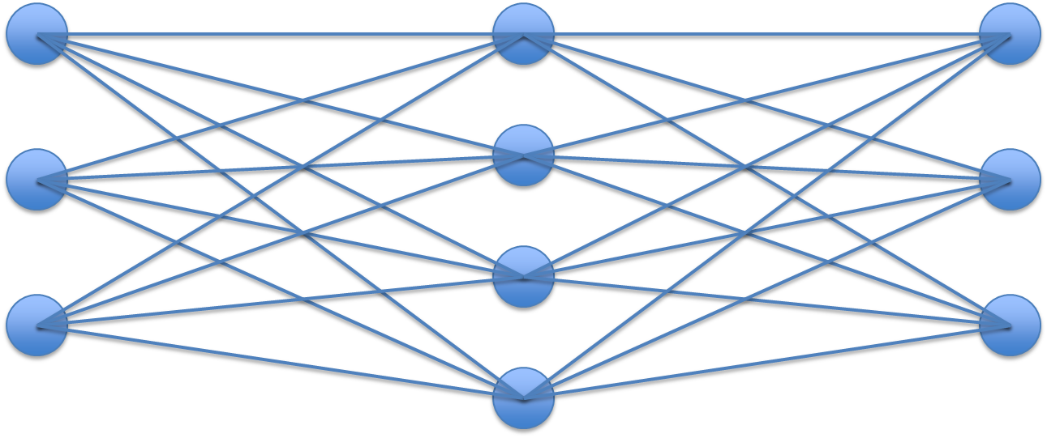
Machine Learning and Deep Learning
Your Full Name and My Full Name (54)
Ramu Battu and Nitaigour P Mahalik
Department of Industrial Technology, Jordan College of Agricultural Science and Technology, California State University, Fresno, California, USA
ABSTRACT
METHODOLOGY
RESULTS
This study investigates the relationship between Artificial Intelligence (AI), Machine Learning (ML), and Deep Learning (DL), with a focus on how neural networks enable automated learning from data. The research compares traditional rule-based AI systems with modern data-driven approaches, highlighting the transition from manually programmed logic to models that learn patterns through training data. Machine Learning methods are analyzed in terms of their ability to extract patterns from structured datasets using statistical and algorithmic techniques, while Deep Learning is examined as an advanced subset of ML that utilizes multi-layered artificial neural networks to learn hierarchical representations from unstructured data such as images, text, and audio. Among these approaches, traditional ML methods require manual feature extraction and perform effectively on smaller, structured datasets, whereas deep learning models automatically learn features but require large datasets and higher computational resources. Neural network models, as demonstrated in digit recognition systems, show improved accuracy through layered processing of inputs using weighted connections and activation functions. Findings from the reviewed literature indicate that deep learning consistently outperforms traditional machine learning in complex pattern recognition tasks due to its ability to learn directly from raw data. Overall, the study highlights the hierarchical relationship between AI, ML, and DL and emphasizes the importance of neural networks in advancing modern intelligent systems across domains such as computer vision, natural language processing, and autonomous systems.
This project uses a qualitative research approach based on secondary sources.
Steps:
Review academic and educational materials on AI, ML, and DL
Analyze neural network structures and learning processes
Compare ML and DL based on:
Data requirements
complexity
performance
Use a digit-recognition neural network example to explain concepts
Deep learning models consistently outperform traditional machine learning methods in complex tasks such as image recognition, natural language processing (NLP), and speech analysis by learning patterns directly from large datasets
1. The integration of ML and DL improves overall system performance by increasing prediction accuracy, automation, and the ability to process both structured and unstructured data
Applications across industries demonstrate strong real-world impact:
Healthcare: More accurate disease detection, medical imaging analysis, and predictive diagnostics
Finance: Improved fraud detection systems and risk assessment models
Autonomous systems: Enhanced decision-making in self-driving cars, robotics, and drones
NLP: More advanced chatbots, real-time translation, and sentiment analysis
This confirms that ML and DL technologies are highly versatile and adaptable across industries.
2. Model performance depends heavily on:
Access to large, high-quality labeled datasets for effective training
High computational power, especially GPUs, to handle complex calculations and large-scale data
Deep learning models require significantly more training time and computational resources compared to traditional ML models, but they provide faster and more accurate results during execution.
3. Emerging trends are expanding capabilities and efficiency:
Transfer learning reduces training time by reusing pre-trained models
Explainable AI (XAI) improves transparency and trust in model decisions
Federated learning enables training while preserving data privacy
Integration with IoT and edge computing allows real-time data processing
These advancements are expanding the capabilities and accessibility of ML and DL systems.
4. Despite strong performance, several challenges remain:
Limited availability of labeled data in certain domains
High computational and energy costs for training deep models
Lack of interpretability due to the “black-box” nature of DL systems
Ethical concerns, including bias in algorithms and data privacy issues
These challenges highlight the need for continued research and responsible implementation.
5. Overall Finding
The combined evidence shows that integrating ML and DL leads to:
• Higher predictive accuracy
• Faster processing of complex data
• Broader real-world applicability
However, success depends on balancing performance with ethical considerations, data quality, and computational efficiency.
START │ ▼ Collect & Review Sources (Coursera, TDS, GeeksforGeeks, 3Blue1Brown) │ ▼ Analyze AI, ML, DL Concepts │ ▼ Convert Image → Numerical Data (Pixels → Values 0–1) │ ▼ Process Through Neural Network (Input → Hidden Layers → Output) ───▶ | END (Conclusions) ▲ │ Evaluate Performance & Concepts ▲ │ Compare ML vs DL Approaches ▲ │ Model Learns Patterns (Edges → Shapes → Digits) ▲ │ Activation Functions (ReLU / Sigmoid)Compare ML vs DL Approaches ▲ │ Apply Weights + Biases Evaluate
INTRODUCTION AND BACKGROUND
Artificial Intelligence refers to computer systems capable of performing tasks such as decision-making, prediction, and pattern recognition. Early AI systems were rule-based, meaning they relied on predefined instructions and lacked adaptability.
Machine Learning introduced a paradigm shift by allowing systems to learn directly from data. Instead of programming rules manually, ML algorithms identify patterns and improve through experience. According to Coursera, this enables systems to adapt with minimal human intervention.
Deep Learning extends machine learning by using multi-layered neural networks inspired by the human brain. As described by Towards Data Science, deep learning models process information through hierarchical layers, allowing them to understand complex and unstructured data such as images, audio, and text.
LITERATURE REVIEW
DESIGNS
Artificial Intelligence (AI): Artificial Intelligence represents the broad field of developing systems capable of performing tasks that typically require human intelligence, including decision-making, prediction, and pattern recognition. Early AI systems were primarily rule-based, relying on explicitly programmed logic to process inputs and produce outputs. While effective in controlled environments, these systems lacked adaptability and required continuous human intervention to update rules, limiting their scalability and performance in dynamic real-world scenarios (Coursera, 2025; Towards Data Science, 2025).
Machine Learning (ML): Machine Learning extends AI by enabling systems to learn patterns directly from data rather than relying on predefined rules. ML algorithms analyze structured datasets and improve performance through experience. Common approaches include supervised learning, unsupervised learning, and reinforcement learning, each suited to different types of problems such as classification, clustering, and decision-making (GeeksforGeeks, 2026).
ML is particularly effective for structured data and smaller datasets, where features must be manually selected through a process known as feature engineering. While ML models are generally easier to interpret and require less computational power, their performance depends heavily on the quality of the selected features. As a result, ML can become limited when dealing with complex or unstructured data such as images, audio, or natural language (Coursera, 2025; Towards Data Science, 2025).
Deep Learning (DL): Deep Learning is a subset of machine learning that utilizes artificial neural networks with multiple hidden layers to automatically learn complex patterns from raw data. Unlike traditional ML, deep learning eliminates the need for manual feature extraction by learning hierarchical representations directly from input data. Early layers detect simple features such as edges, while deeper layers combine these into more complex patterns such as shapes and objects (Towards Data Science, 2025).
Deep learning models require large datasets and significant computational resources, often relying on GPUs for efficient training. However, they consistently outperform traditional ML methods in tasks involving unstructured data, including image recognition, speech processing, and natural language understanding (GeeksforGeeks, 2026).
Neural Networks: Neural networks form the foundation of deep learning and are inspired by the structure of the human brain. As demonstrated by 3Blue1Brown, a neural network consists of interconnected layers of neurons, where each neuron holds a numerical value known as an activation. These activations are determined by weighted connections and biases, which are adjusted during training.
Information flows from the input layer through hidden layers to the output layer, where predictions are generated. The learning process involves optimizing thousands of parameters (weights and biases) to minimize error and improve accuracy. This layered structure enables neural networks to model complex, non-linear relationships in data, making them highly effective for pattern recognition tasks.
Comparison of Machine Learning and Deep Learning: Machine Learning and Deep Learning differ significantly in their approach to data processing and model complexity. ML models require manual feature extraction and perform well on structured datasets with limited size, while DL models automatically learn features and excel with large-scale, unstructured data.
ML is computationally efficient and interpretable, but its performance is constrained by feature selection. In contrast, DL requires greater computational resources and training time but achieves higher accuracy in complex applications. These differences highlight the importance of selecting the appropriate method based on data characteristics, resource availability, and problem complexity (Coursera, 2025; GeeksforGeeks, 2026).
Summary of Findings: The reviewed literature demonstrates that AI, ML, and DL are not competing approaches but rather a hierarchical progression of technologies. Machine learning improves upon rule-based AI by enabling data-driven learning, while deep learning further advances this capability by automatically extracting features and modeling complex relationships.
Figure 1: Neural Network (Input → Hidden → Output)
DISCUSSION AND CONCLUSIONS
The findings show that combining machine learning (ML) and deep learning (DL) creates more powerful and adaptable systems, especially for complex real-world data
Deep learning is highly effective for unstructured data like images, text, and audio, while traditional ML works well for structured and simpler tasks, making model selection important
ML and DL have a strong impact across industries, especially in healthcare, finance, autonomous systems, and natural language processing, improving accuracy and automation
However, their performance depends on large labeled datasets and high computational power, which can limit use in smaller or resource-limited settings
A key challenge is the “black-box” nature of DL models, which reduces transparency and makes decision-making difficult to interpret in critical applications
Emerging methods such as transfer learning, explainable AI (XAI), and federated learning help improve efficiency, privacy, and interpretability
In conclusion, ML and DL are essential to modern AI, significantly improving prediction, automation, and decision-making across many fields
Despite their success, challenges like data requirements, computational cost, interpretability, and ethics still need to be addressed
Future research will focus on building more efficient, transparent, and scalable models, expanding into areas like healthcare, smart systems, and climate applications
Overall, ML and DL will continue driving innovation and shaping the future of artificial intelligence and society
A neural network consists of multiple layers:
Input Layer
Receives raw data (e.g., 28×28 pixel image = 784 inputs)
Hidden Layers
Perform computations using:
Weights (importance of inputs)
Biases (activation thresholds)
Detect patterns such as edges and shapes
Output Layer
Produces final classification (e.g., digits 0–9)
Neural networks function mathematically as:
Weighted sums of inputs
Passed through activation functions (e.g., sigmoid, ReLU)
This layered structure allows systems to learn increasingly complex representations.
Step 1: Input Image (28×28 pixels)
↓
Step 2: Convert to numbers (0–1 grayscale)
↓
Step 3: Hidden Layer 1 → detects edges
↓
Step 4: Hidden Layer 2 → detects shapes
↓
Step 5: Hidden Layer 3 → detects patterns
↓
Step 6: Output Layer → predicts digit (0–9)
REFERENCES
3Blue1Brown. (2017). But What Is a Neural Network?/Deep learning Chapter 1 [Video]. YouTube.
https://www.youtube.com/watch?v=voo3m8eSMCk
Bendimerad, Sabrine. “Artificial Intelligence, Machine Learning, Deep Learning, and Generative AI - Clearly Explained.” Towards Data
Science, 7 Dec. 2025, towardsdatascience.com/artificial-intelligence-machine-learning-deep-learning-and-generative-ai-clearly-explained/.
“Deep Learning vs. Machine Learning: A Beginner’s Guide.” Coursera, 2025,
www.coursera.org/articles/ai-vs-deep-learning-vs-machine-learning-beginners-guide?msockid=2bfeb4c100c061df3ca4a27b01ff60ff.
“Difference between Machine Learning and Deep Learning.” GeeksforGeeks, GeeksforGeeks, 12 Mar. 2026,
www.geeksforgeeks.org/artificial-intelligence/difference-between-machine-learning-and-deep-learning/.
Patil, Dimple & Rane, Nitin & Desai, Pravin & Rane, Jayesh.“(PDF) Machine Learning and Deep Learning: Methods,
Techniques, Applications, Challenges, and Future Research Opportunities.” Research Gate, www.researchgate.net/publication/385110000_Machine_learning_and_deep_learning_Methods_techniques_applications_challenges_and_future_research_opportunities. Accessed 16 Apr. 2026.
Taye, Mohammad Mustafa. “Understanding of Machine Learning with Deep Learning: Architectures, Workflow, Applications and Future
Directions.” MDPI, Multidisciplinary Digital Publishing Institute, 25 Apr. 2023, www.mdpi.com/2073-431X/12/5/91.
Notes:
1

